Slide 1
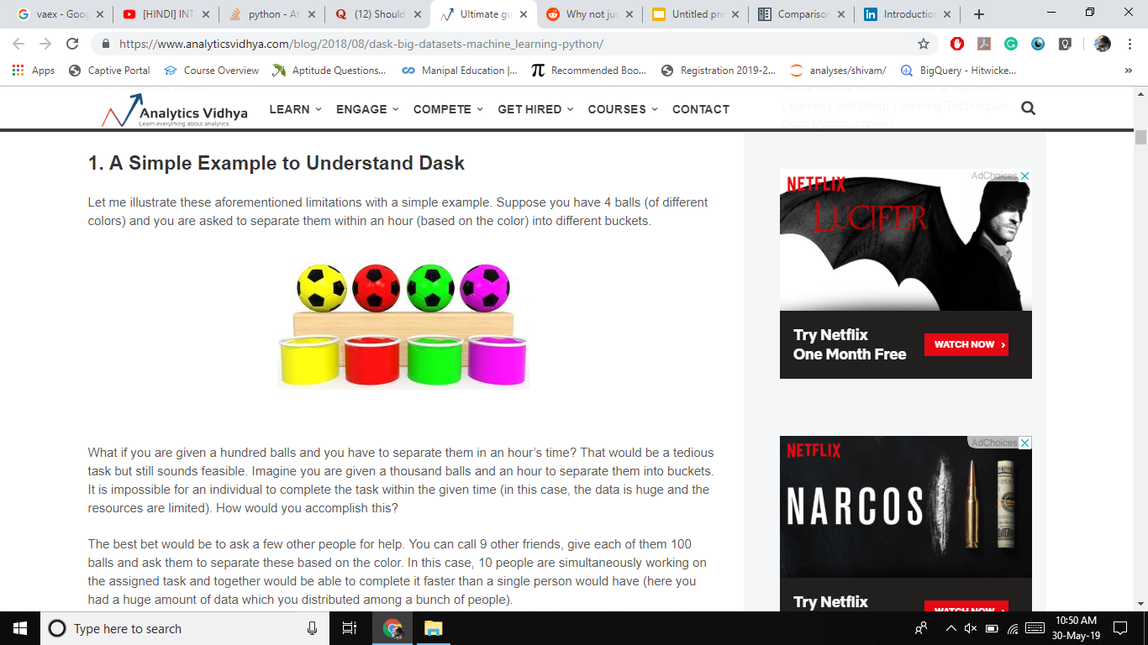

Slide 2
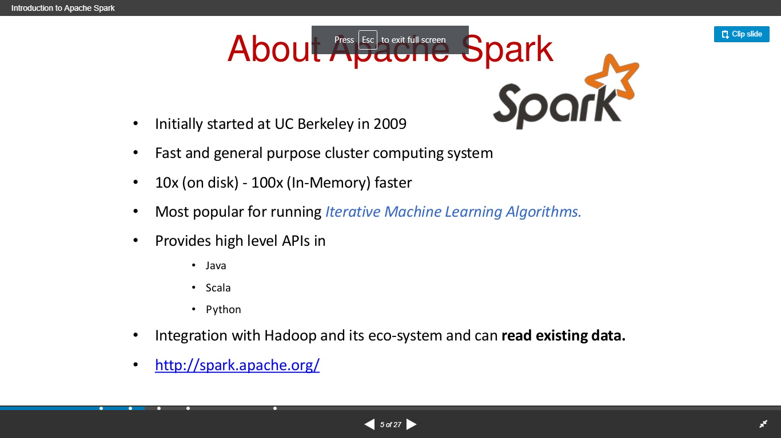

Slide 3
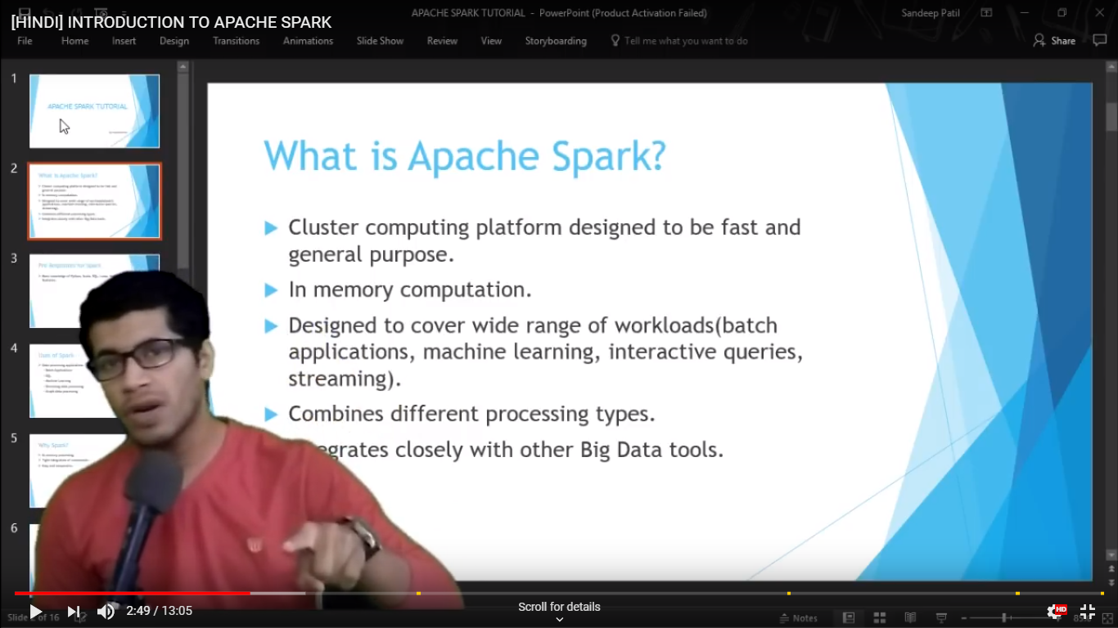

Slide 4


Slide 5
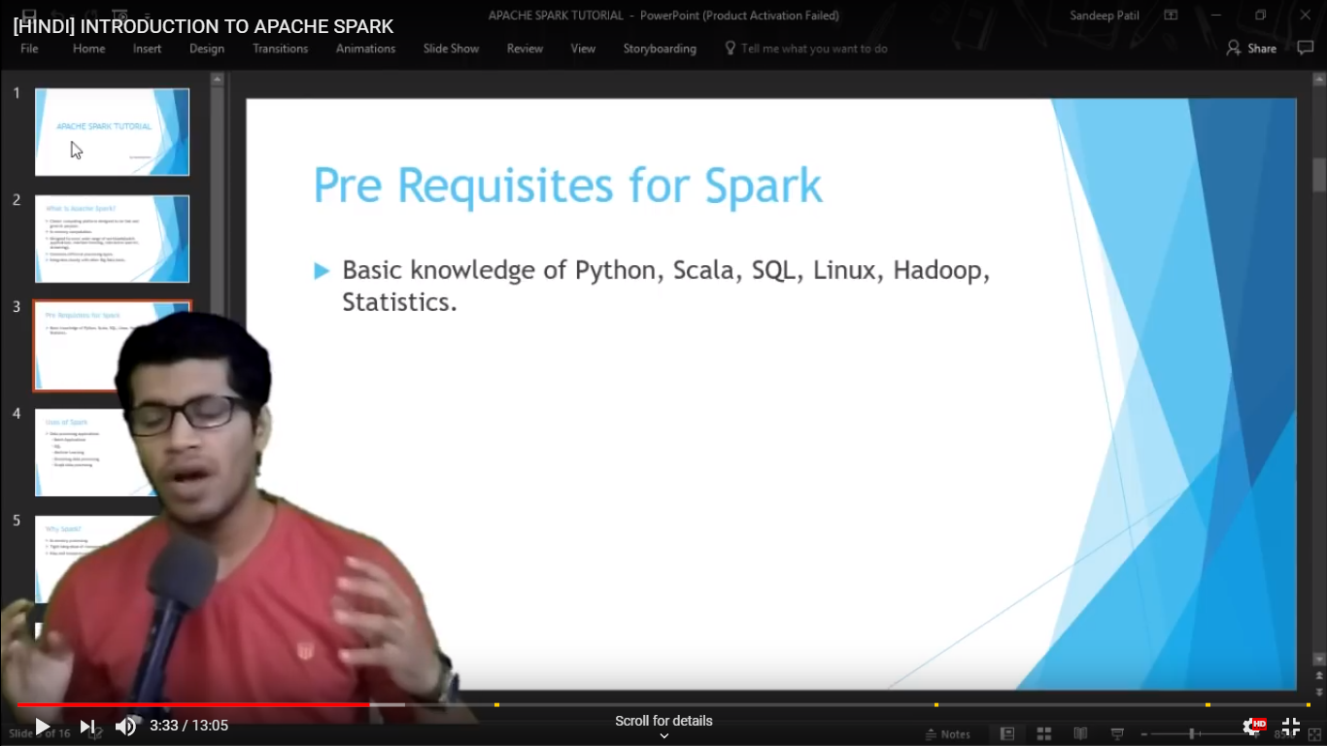

Slide 6
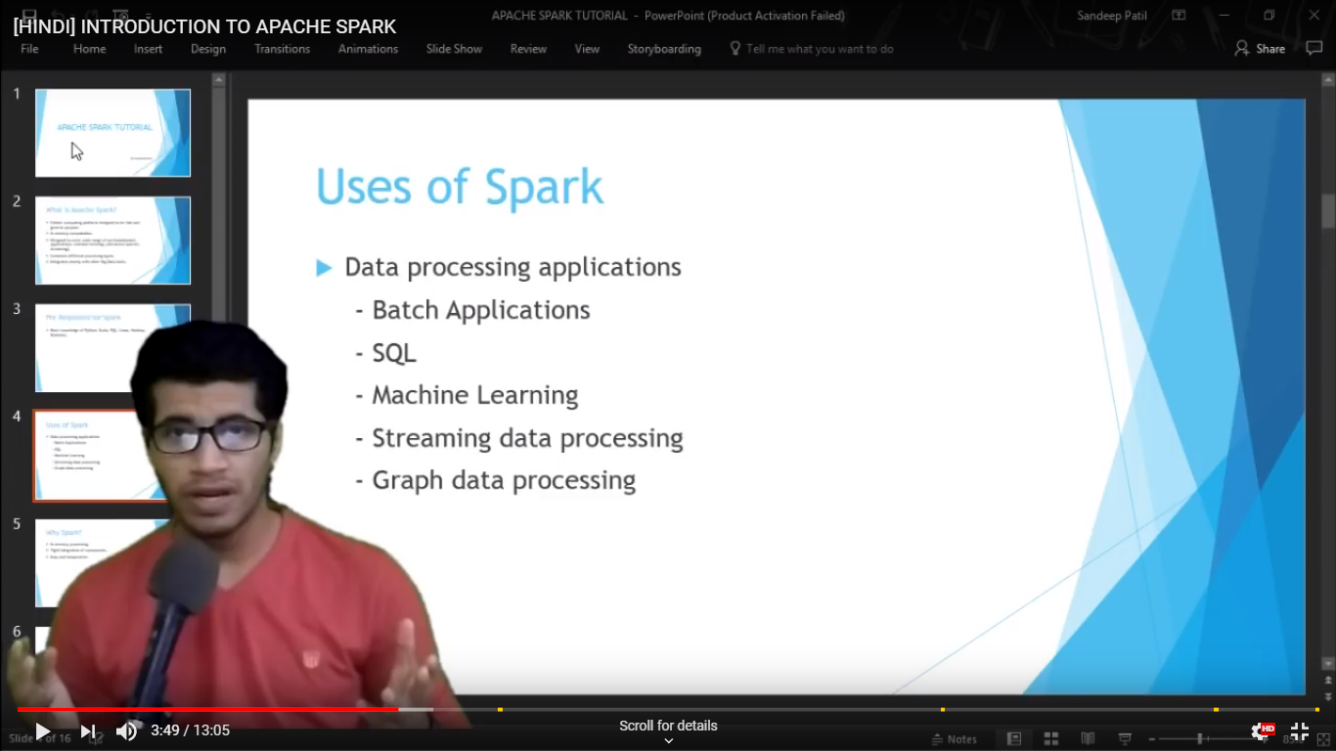
m

Slide 7


Slide 8


Slide 9


Slide 10
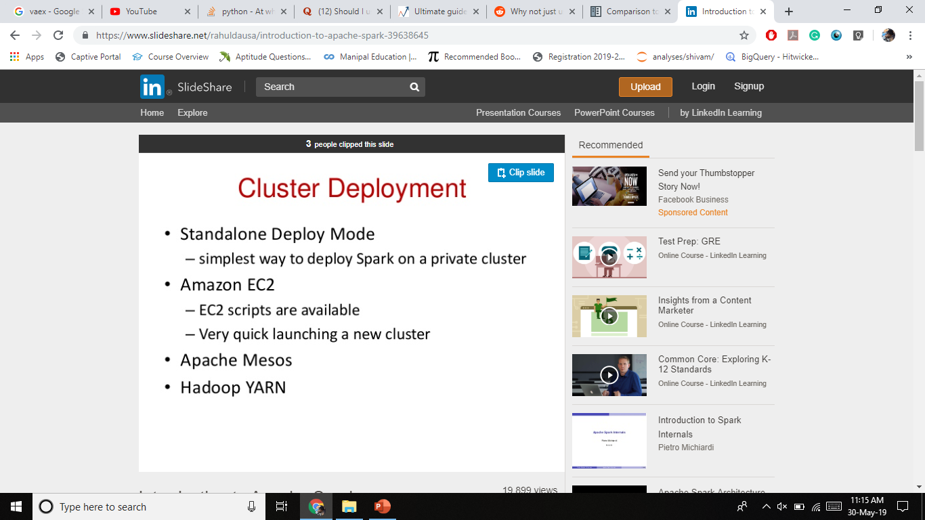

Slide 11
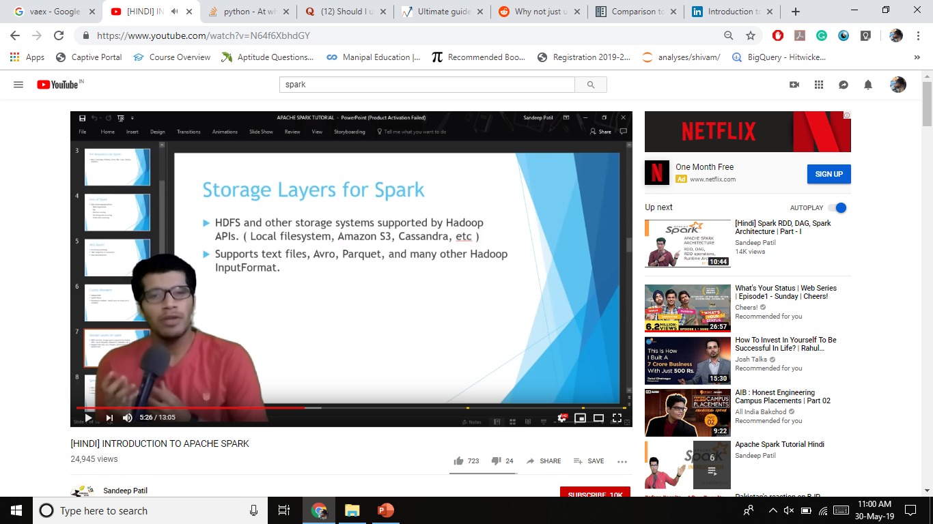

Slide 12


Slide 13


Slide 14
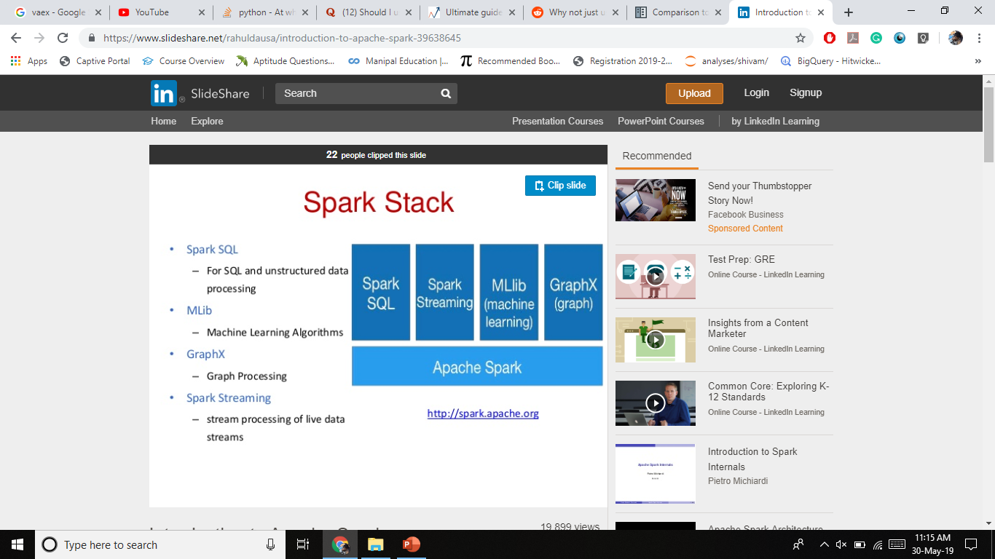

Slide 15
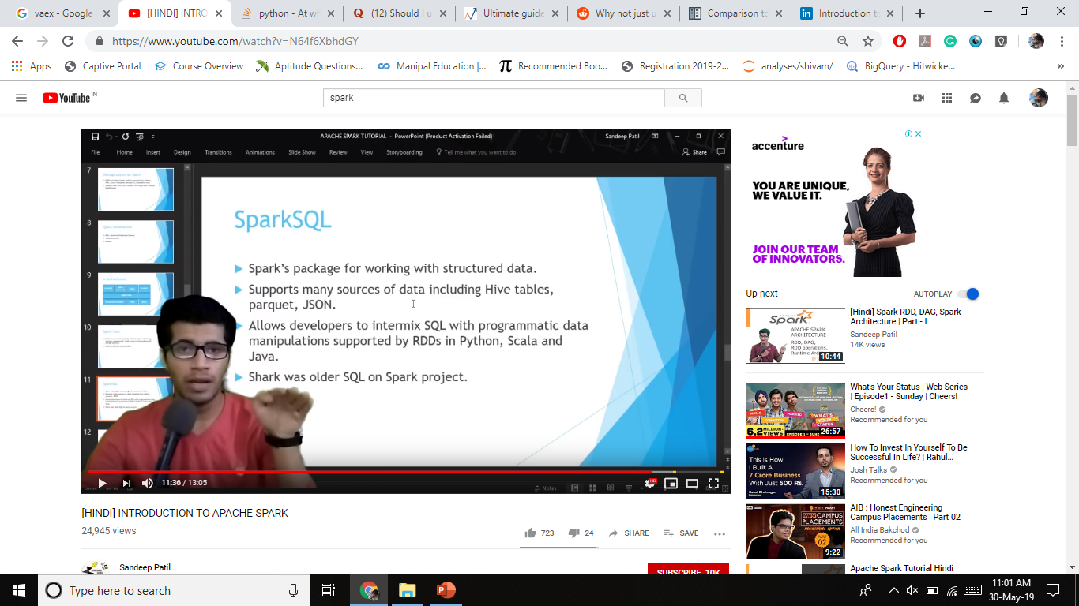

Slide 16


Slide 17
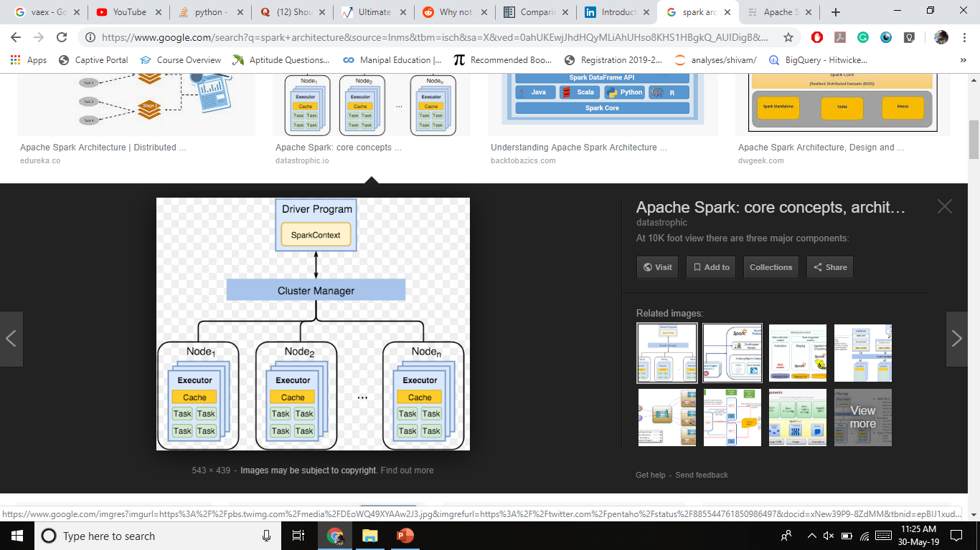
Spark Architecture

Slide 18
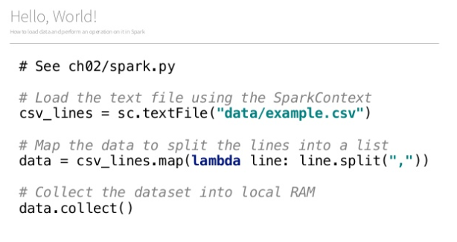

Slide 19
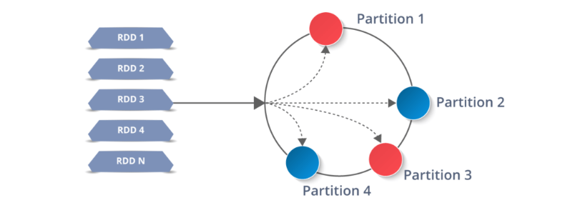

Slide 20
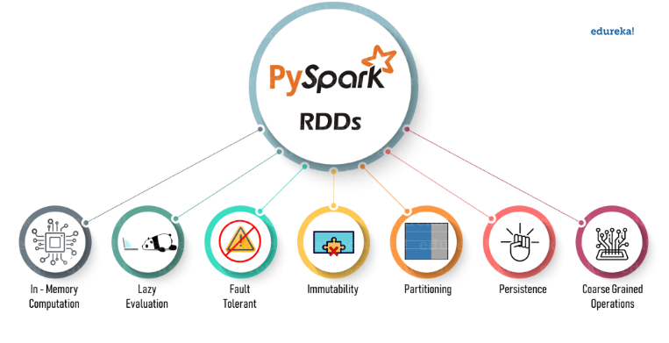

Slide 21
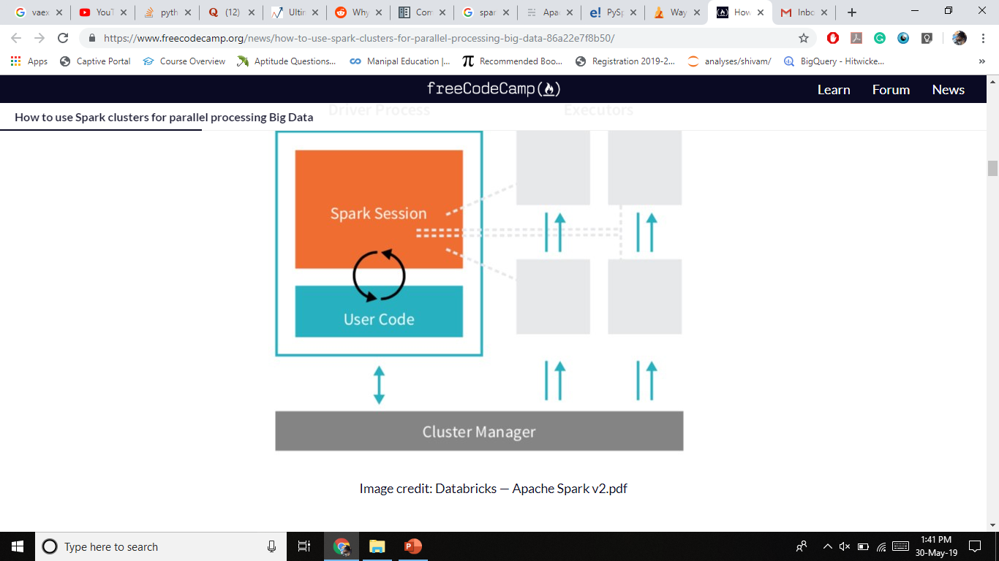

Slide 22
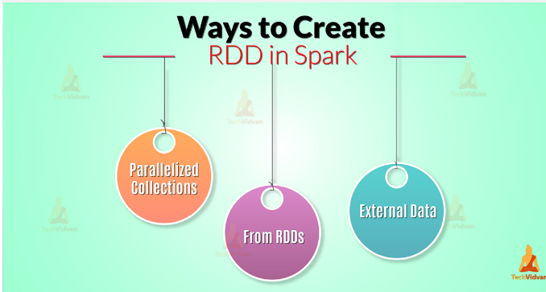
sc.parallelize(data, 20)

Slide 23
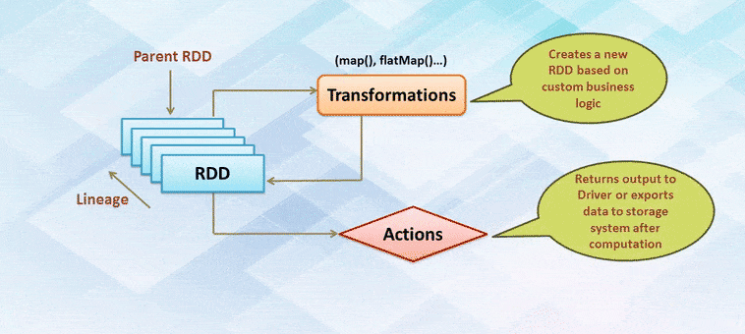
Lazy Evaluation

Slide 24
Machine Learning Pipelines
At the core of the pyspark.ml module are the Transformer and Estimator classes.
Almost every other class in the module behaves similarly to these two basic classes.

Slide 25
PySpark has a submodule for just about everything!

Slide 26
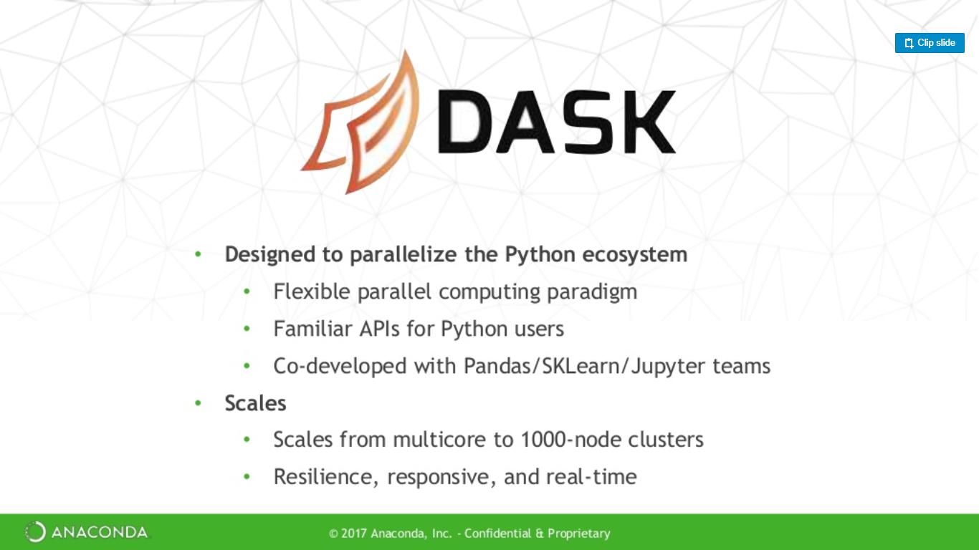

Slide 27
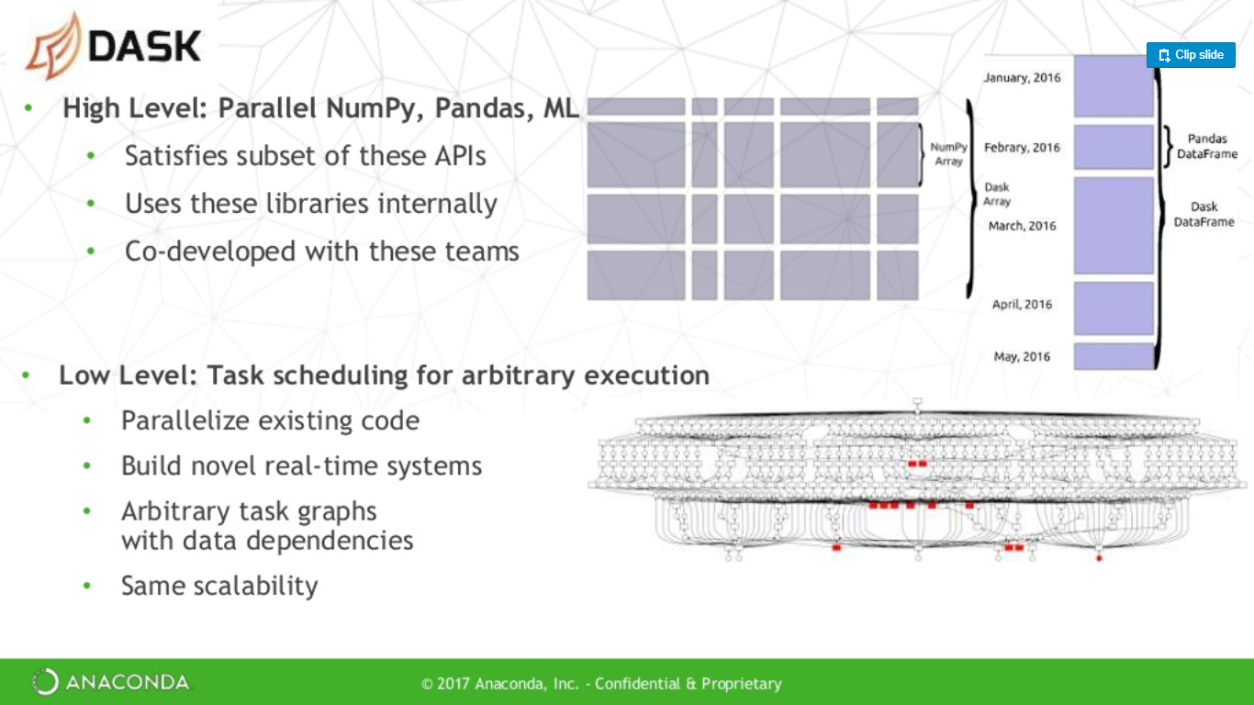

Slide 28
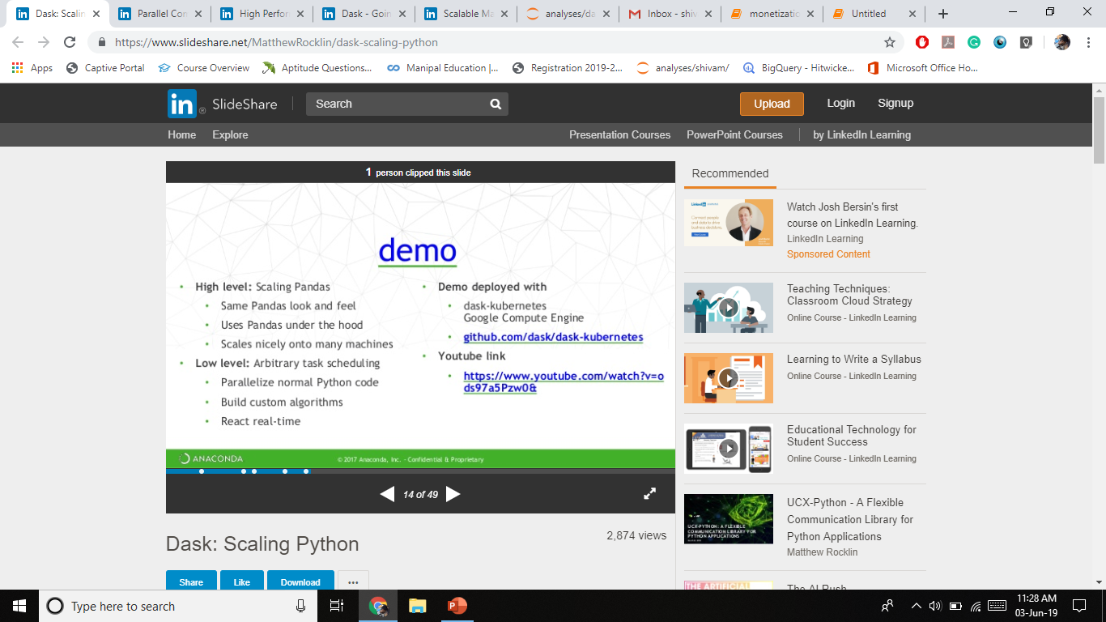

Slide 29
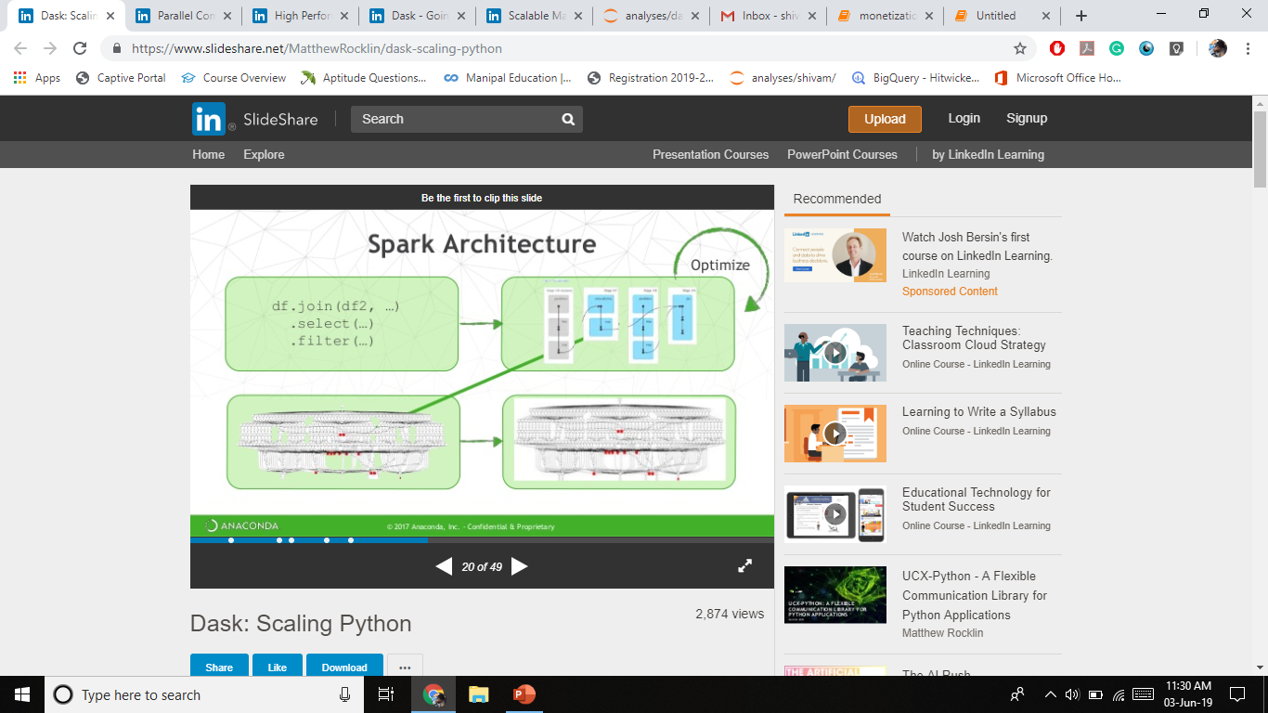

Slide 30
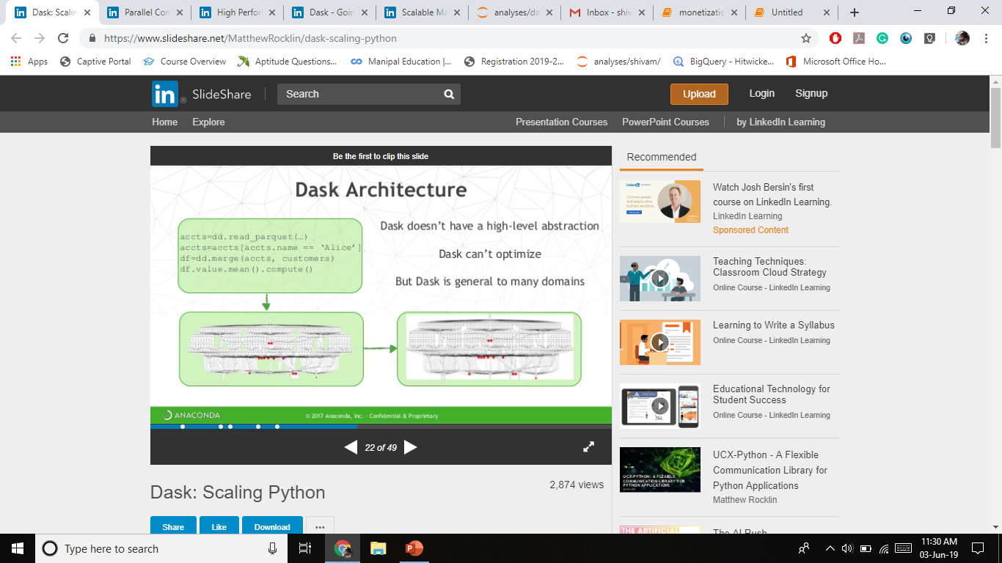

Slide 31


Slide 32
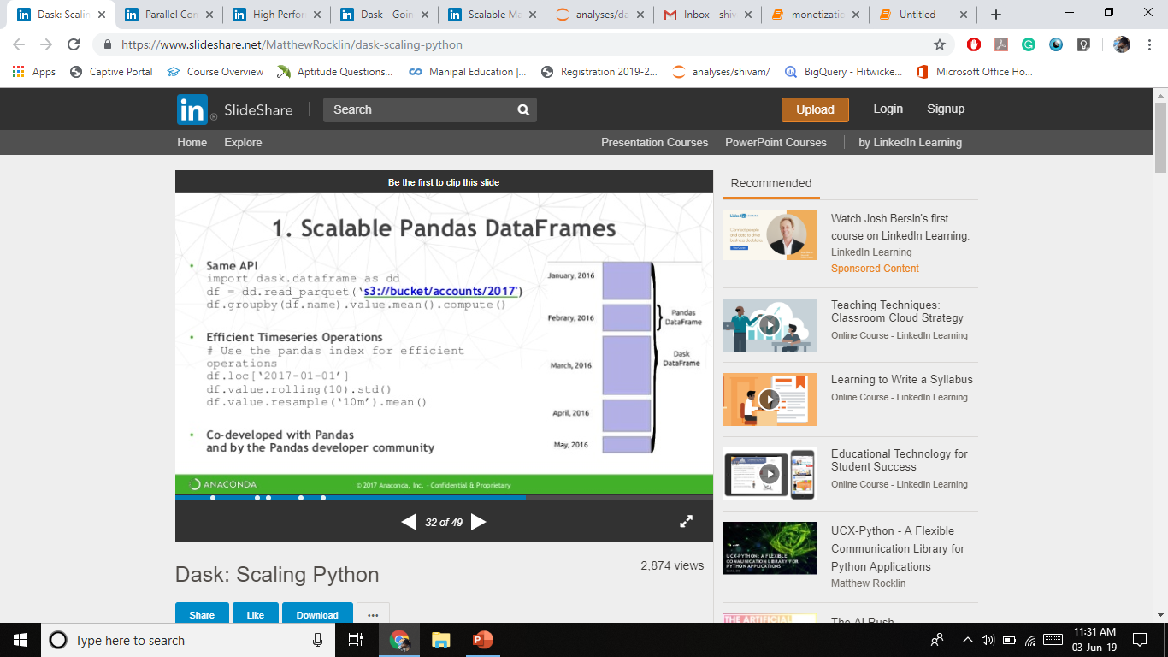

Slide 33
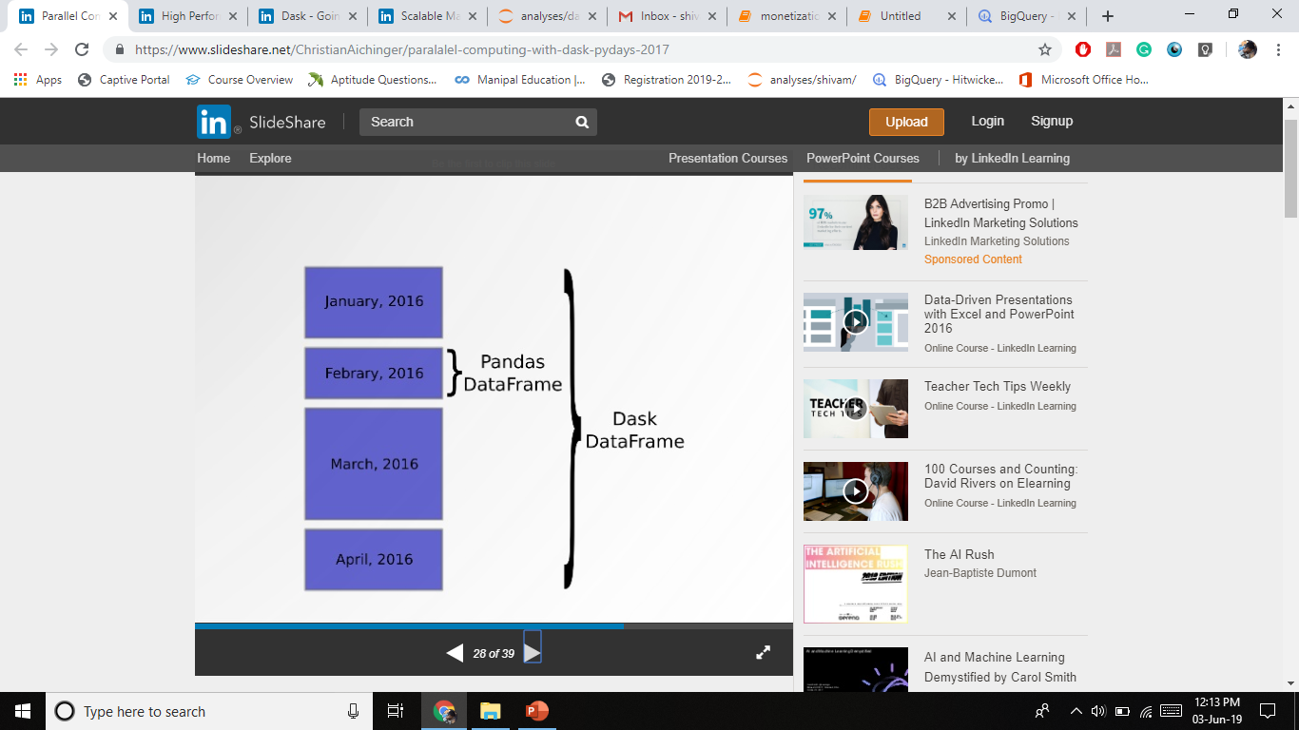

Slide 34
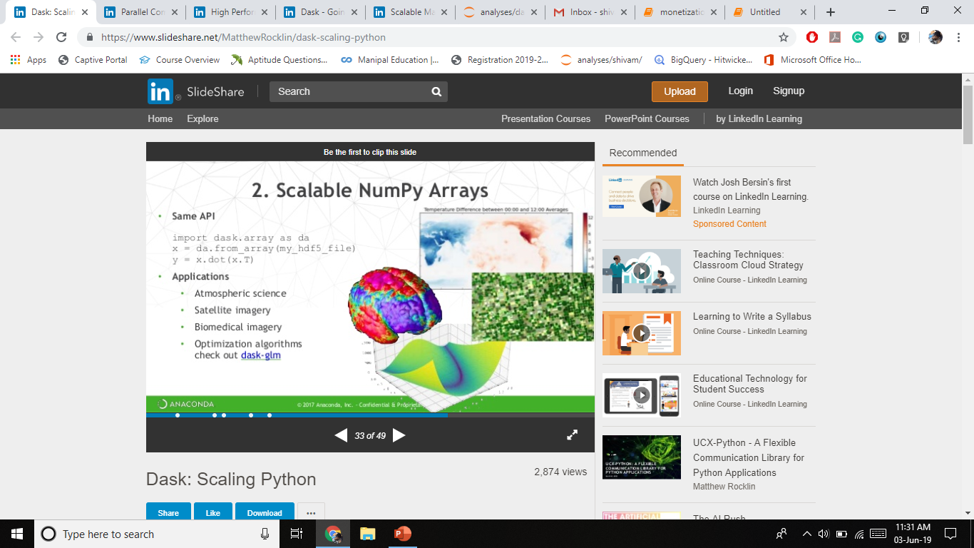

Slide 35
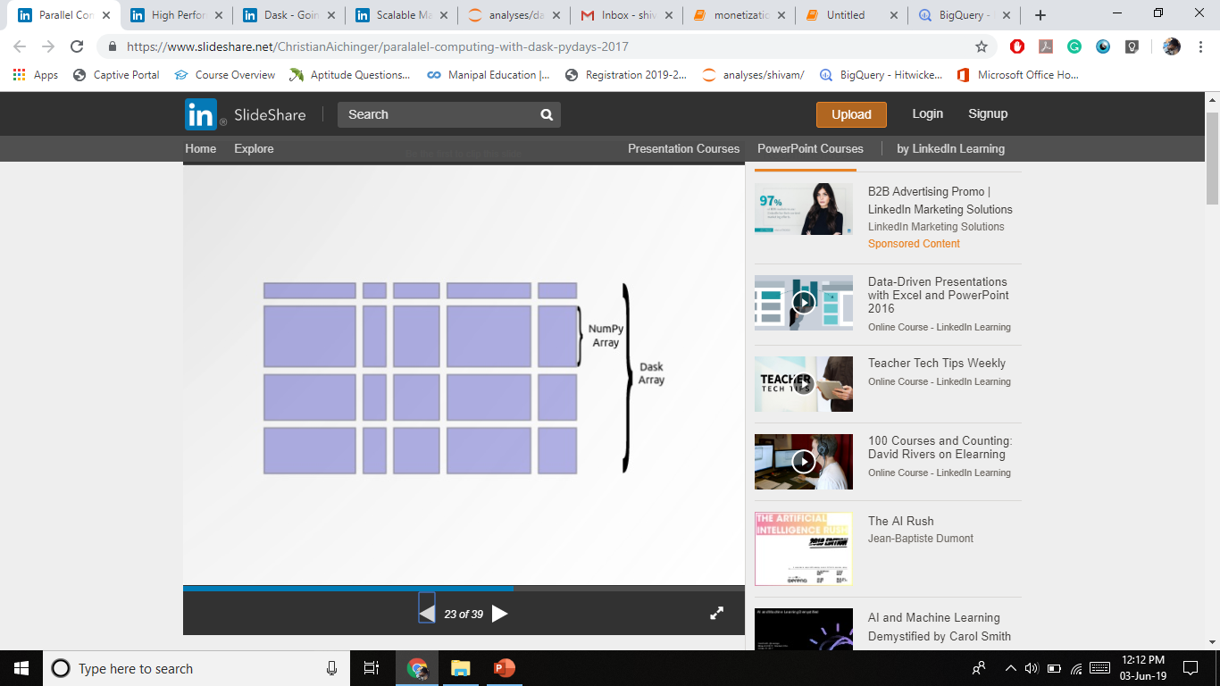

Slide 36
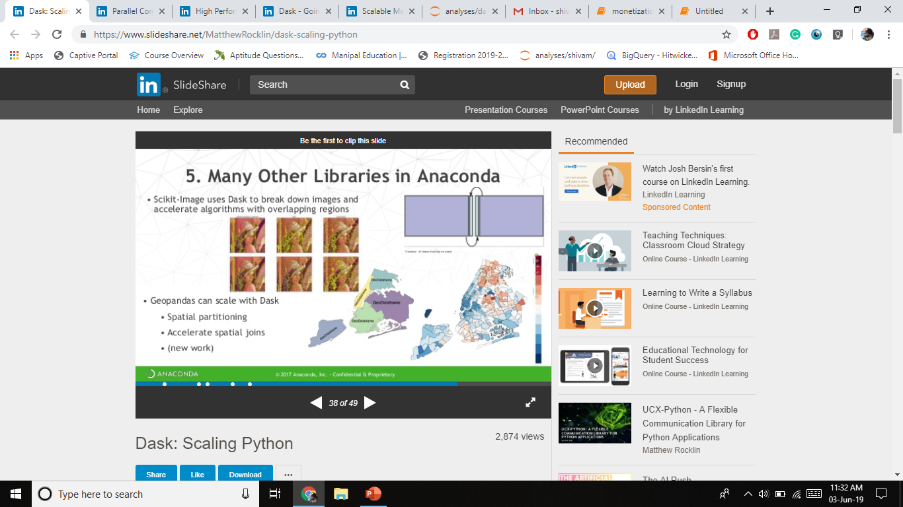

Slide 37


Slide 38
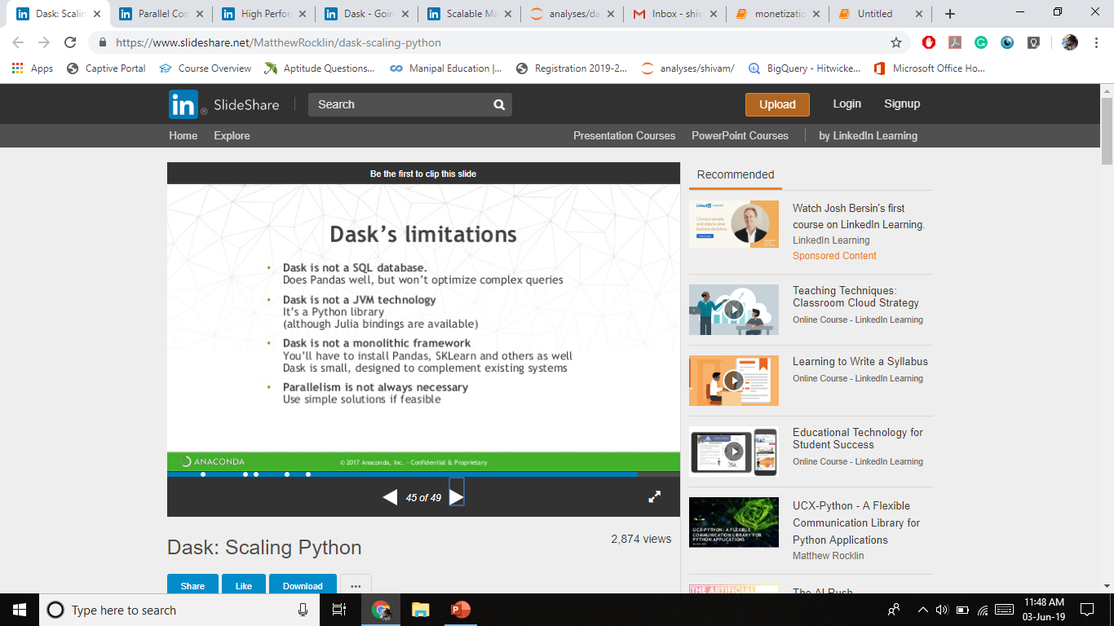

Slide 39
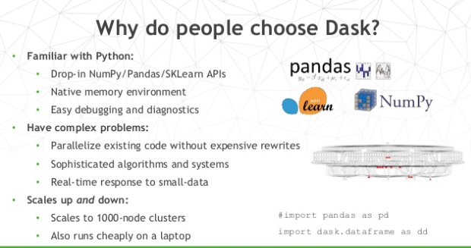

Slide 40
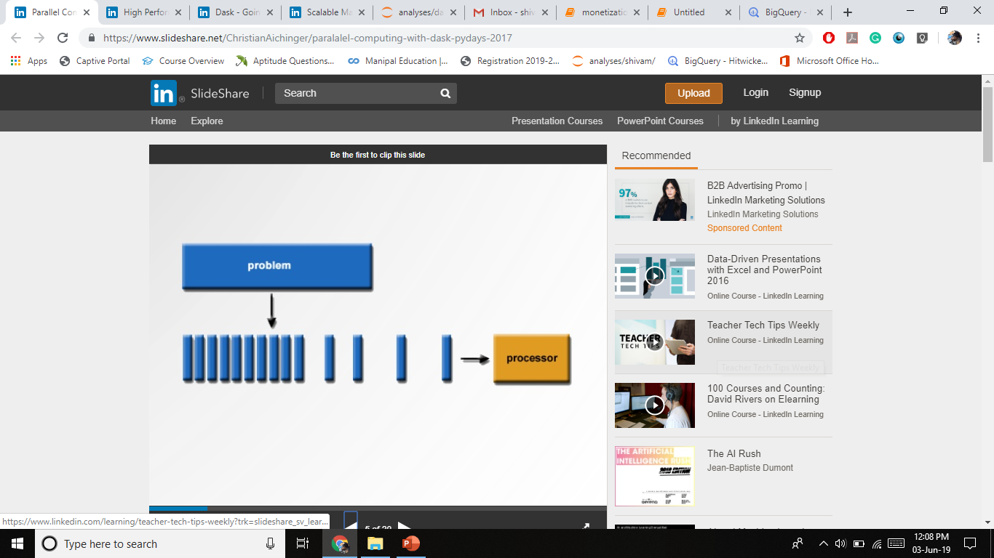

Slide 41
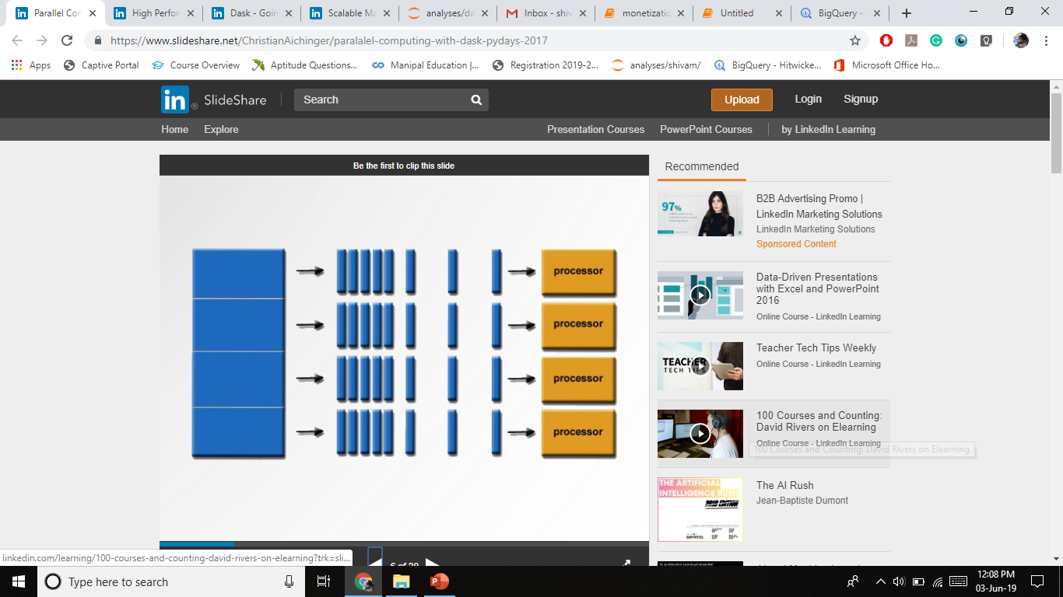

Slide 42
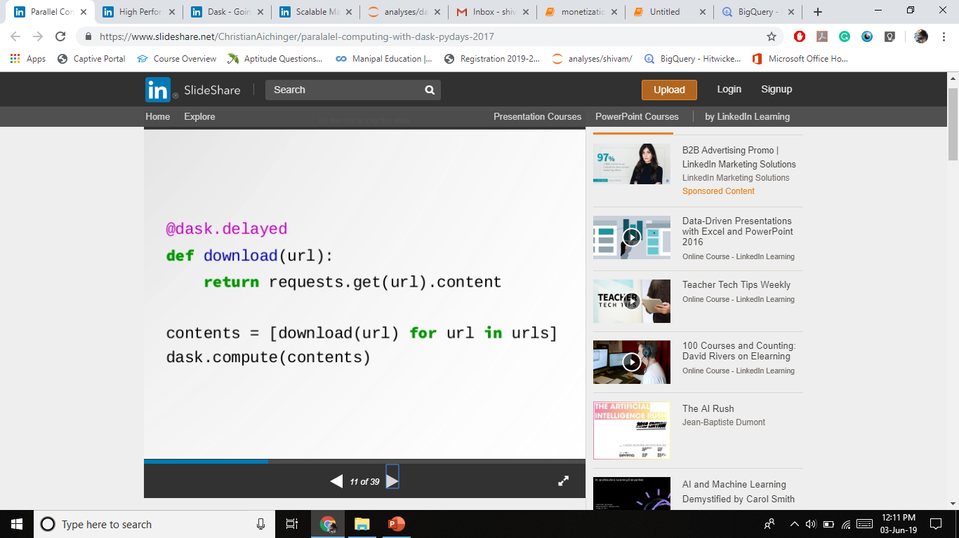

Slide 43
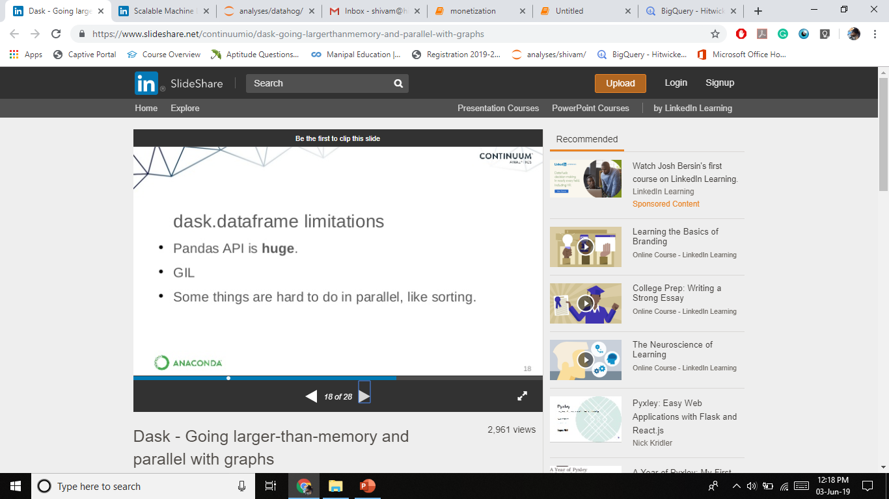

Slide 44
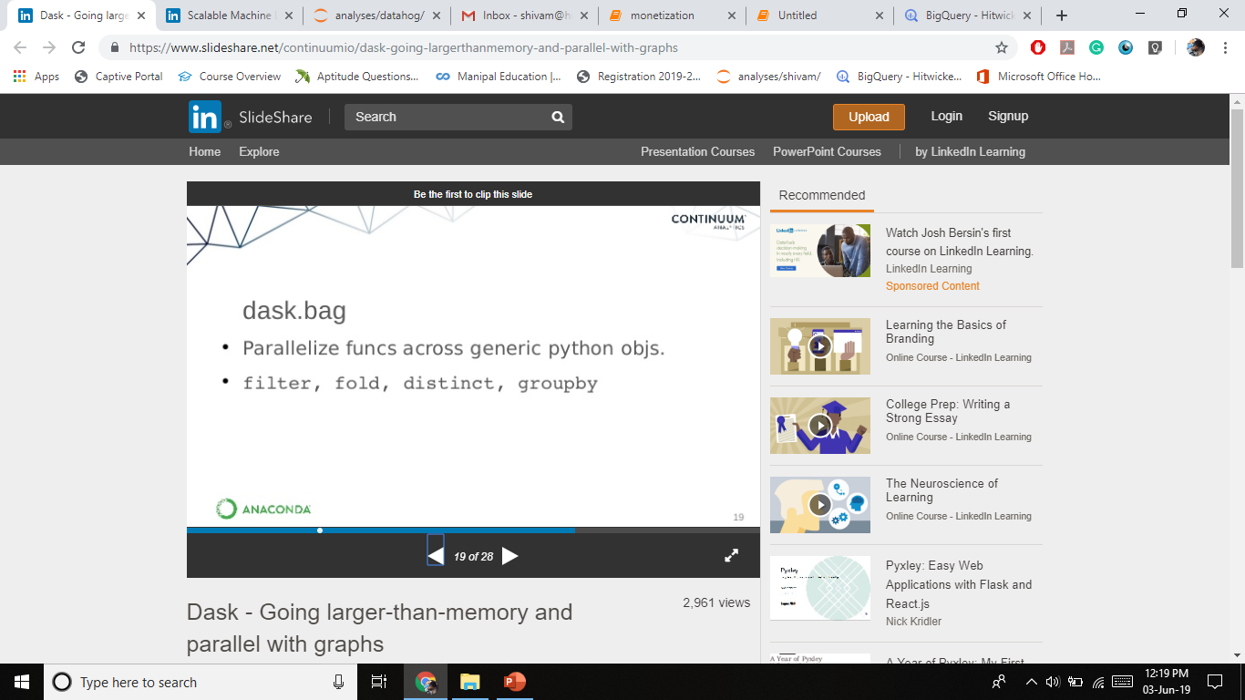

Slide 45
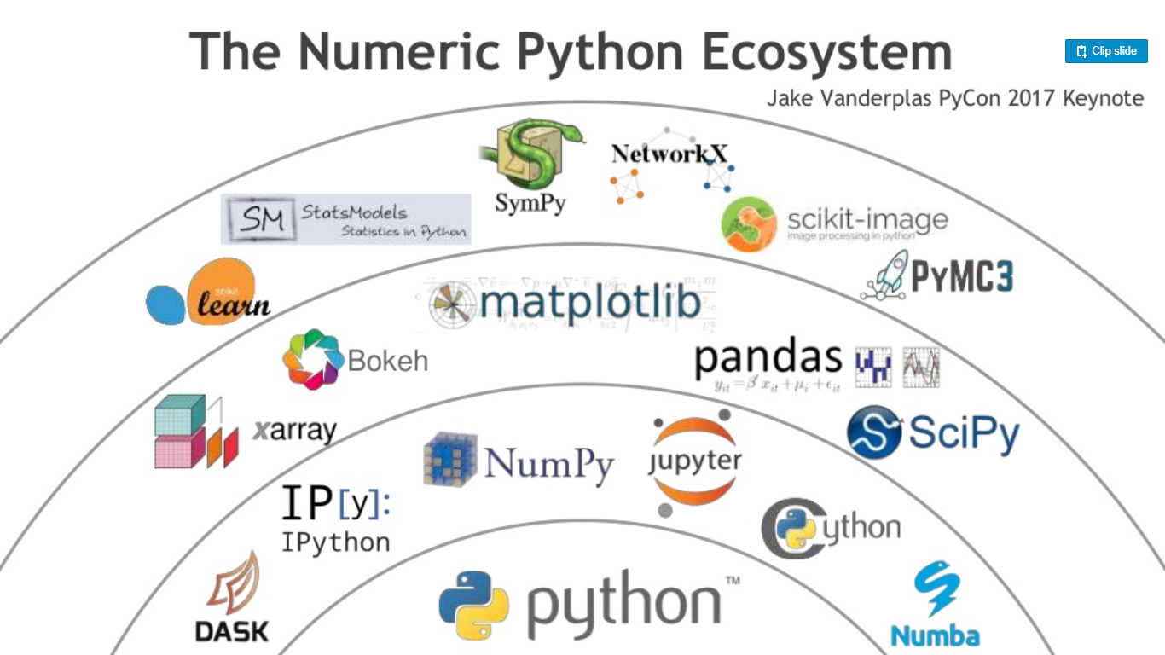

Slide 46
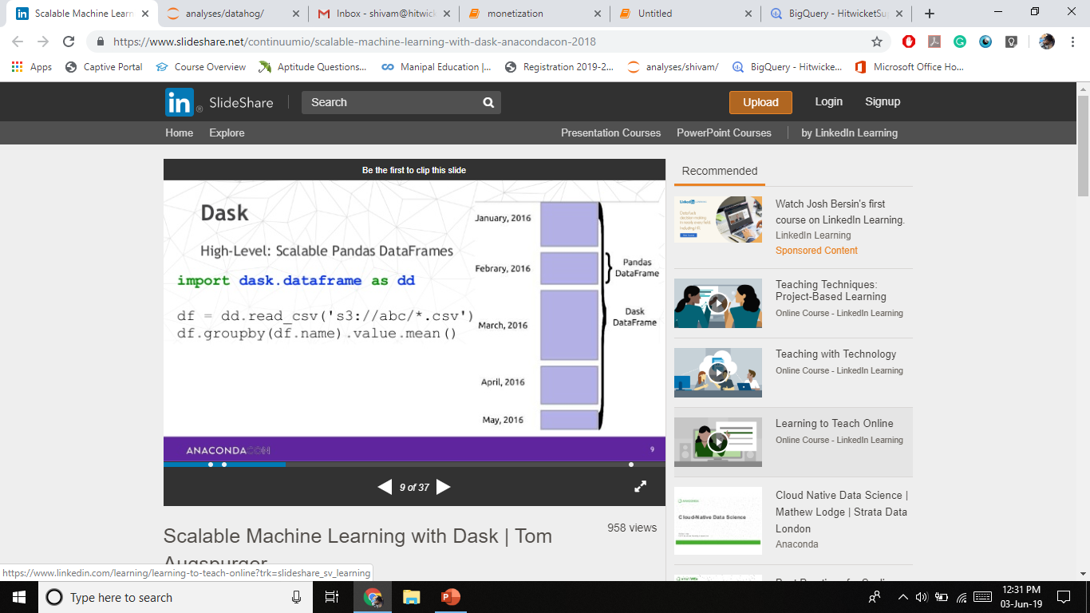

Slide 47
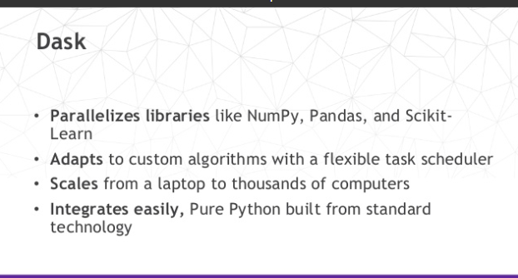

Slide 48
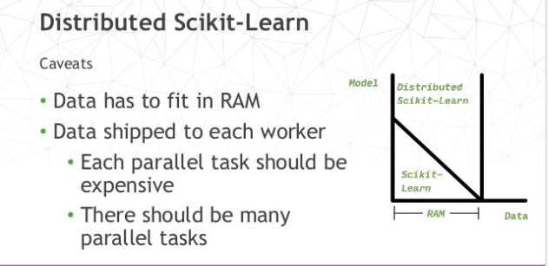

Slide 49
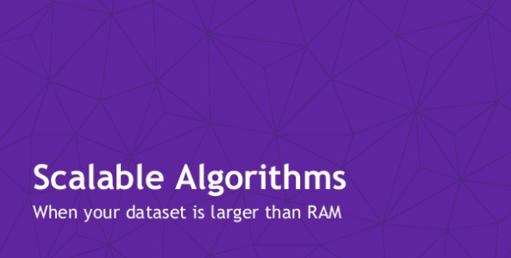

Slide 50
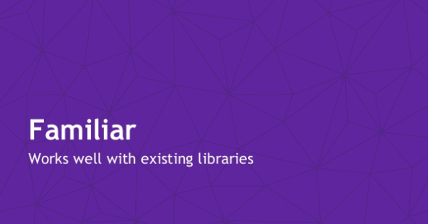

Slide 51
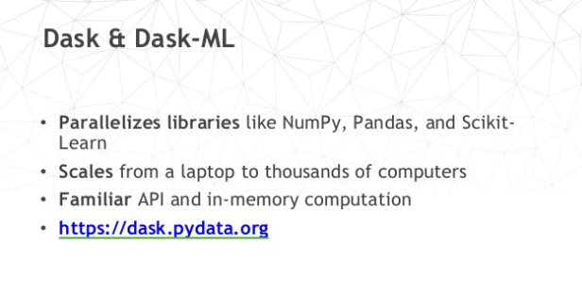

Slide 52
Comparison between Dask and Spark
Dask is light weighted
Dask is typically used on a single machine
Dask to provides parallel arrays, dataframes, machine learning, and custom algorithms
Dask has an advantage for Python users because it is itself a Python library.
Dask is lighter weight and is easier to integrate into existing code and hardware.
If you want a single project that does everything and you’re already on Big Data hardware then Spark is a safe bet
Spark is typically used on small to medium sized cluster but also runs well on a single machine.

